Slide 1
API Manager / Gateway

Slide 2

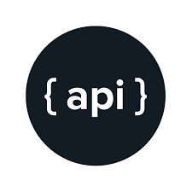














Slide 3

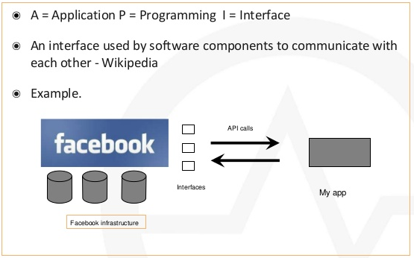

Slide 4
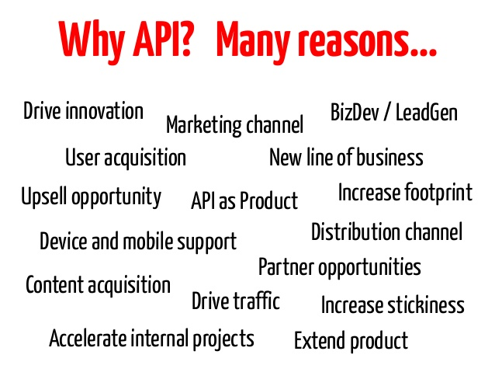

Slide 5

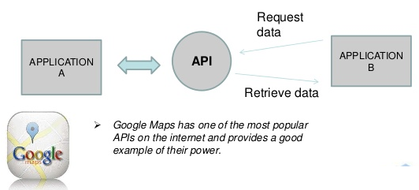

Slide 6
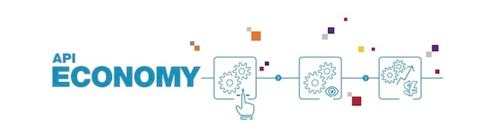
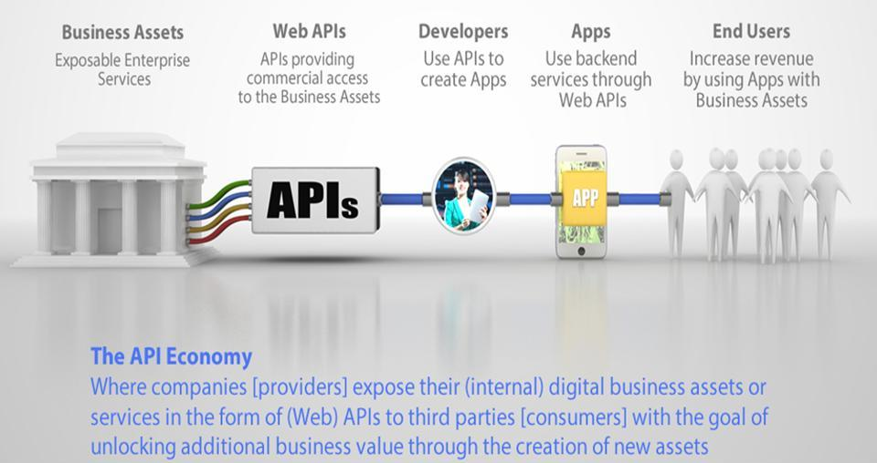

Slide 7
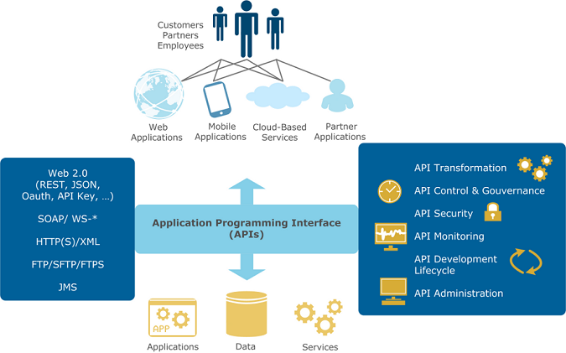

Slide 8










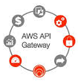



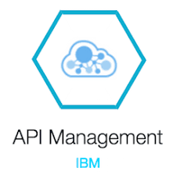

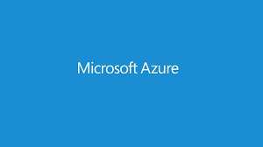



Slide 9
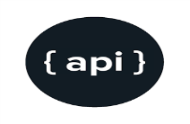

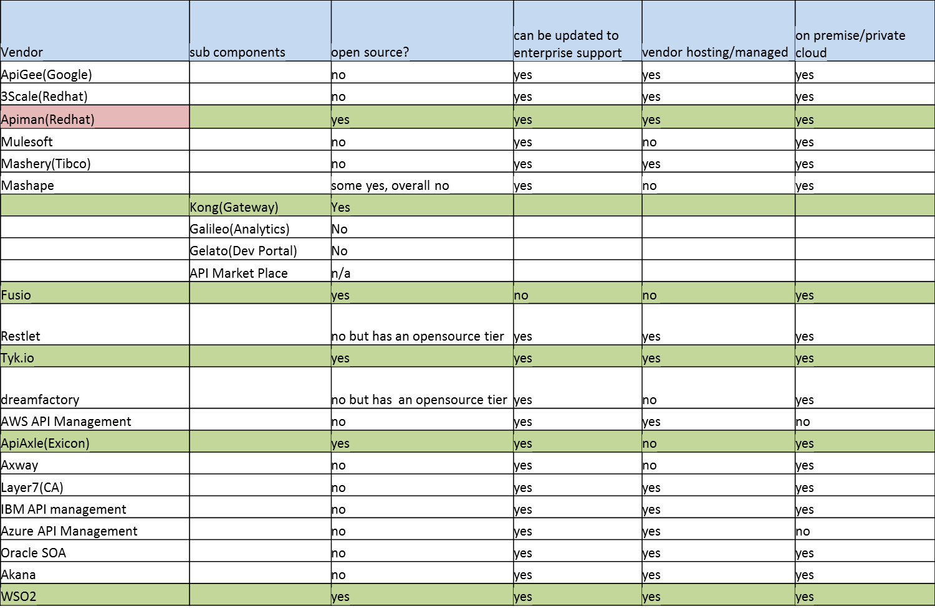

Slide 10


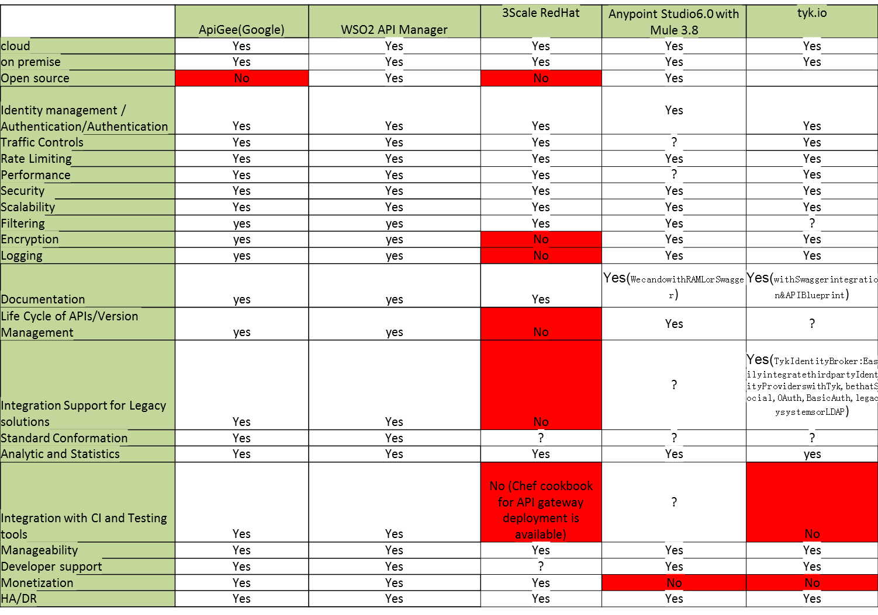

Slide 11
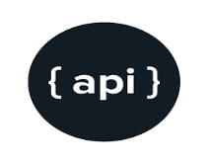
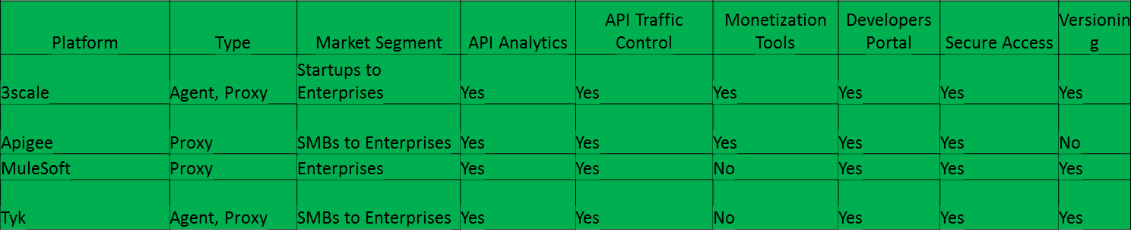

Slide 12
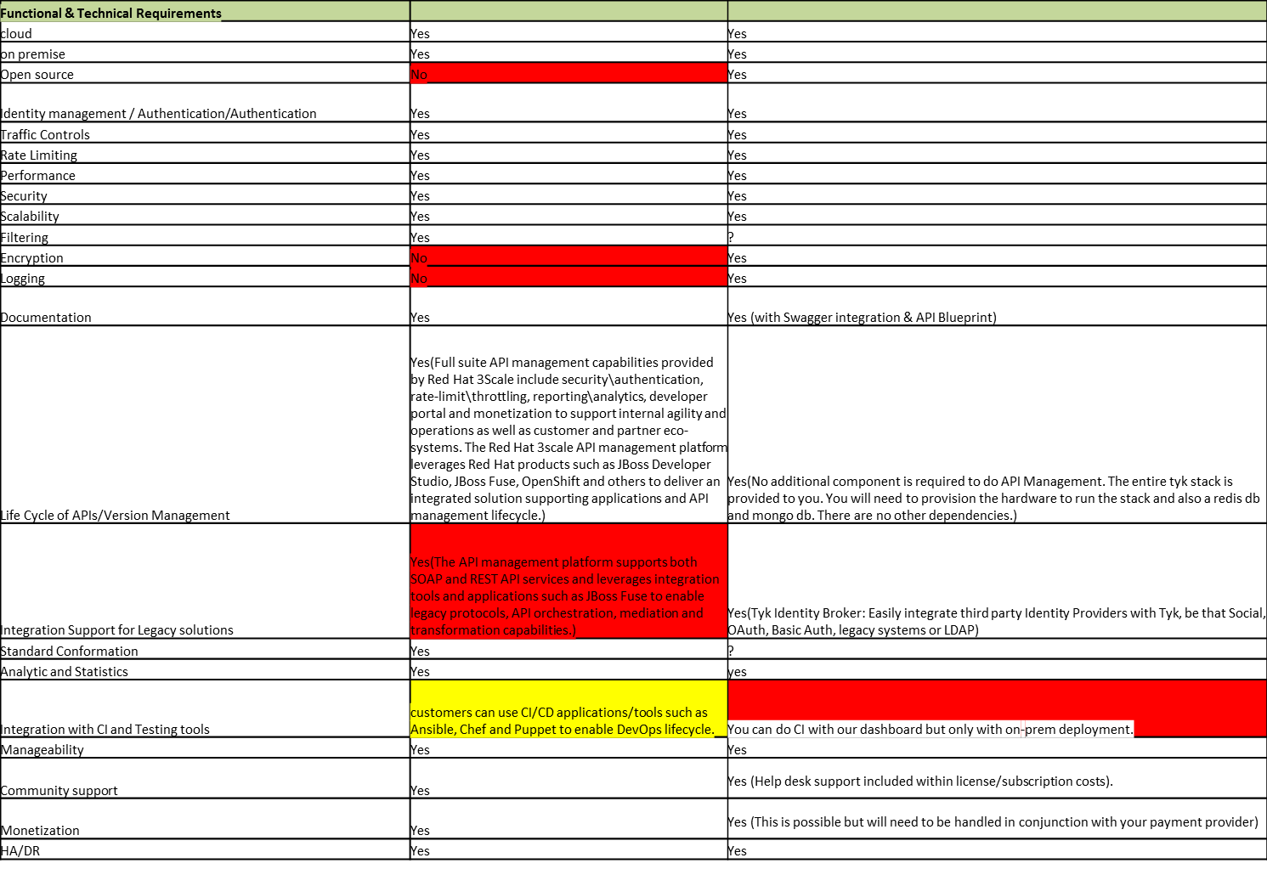

Slide 13





Slide 14

Video tutorial on below topics, provided over shared folder
Part 1 - Registration on 3Scale.net
Part 2 - Admin Portal overview
Part 3 - creating Developer & Application using 3scale admin portal
Part 4 - Creating API Proxy with user_key security policy
Part 5 - Rate Limiting Metric _ Method & Mapping Rule for API Proxy
Part 6 - Analytics on hits
Part 7 - Admin & Developer Communication
Part 8 - Creating Custom Application Plan & Feature and mapping it with existing Application.
Part 9 - Creating ActiveDocs with Swagger Specification for 3scale API Proxy

Slide 15

To See installation steps for Tyk on-premise

Slide 16



